Slide 1
Scope and mechanisms of miR159-mediated gene regulation in Arabidopsis
Junyan Li
Supervisor: Tony Millar (ANU)
Rosemary White (CSIRO)
Frank Gubler (CSIRO)

Slide 2
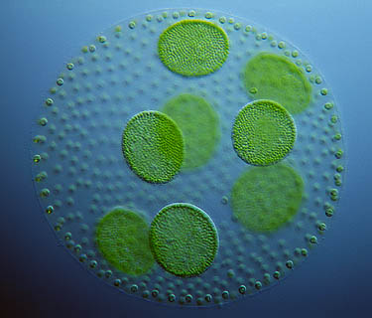


MicroRNA is essential for understanding gene regulation
Discovery of RNA interference (RNAi) has revolutionized our understanding of how gene expression is regulated.
MicroRNAs (miRNA) are endogenously expressed small RNAs which can cause the silencing of genes by the RNAi pathway.
MiRNAs control the expression of key regulatory genes critical for development.
At least 1,000 miRNA genes in humans;
Participate almost every cellular process, including development and human diseases.
Over 200 miRNA genes are expressed in plants.

Slide 3




MiRNA biogenesis in Arabidopsis
MIR gene
v
miRNA precursor
DCL1
21-24 bp
miRNA duplex
HEN1
CH₃
H₃C
Nucleus
HST
Cytoplasm
RISC
AGO1
CH₃
H₃C
Target transcript
mRNA cleavage

Slide 4
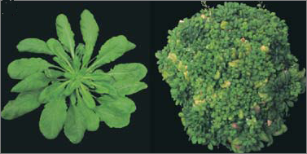
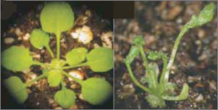
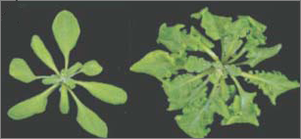
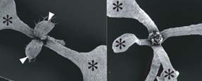
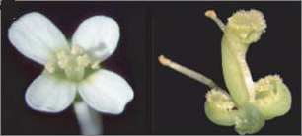
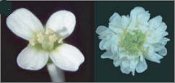
MiRNA mediated gene regulation is critical in plant development
Effects of overexpression
of MIR genes
Consequence of the loss of miRNA-mediated gene regulation
Gene name
WT
Mutant
WT
Mutant
Gene name
miR156b
PHB
ARF17
miR319
miR172
AP2

Slide 5
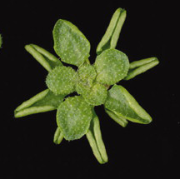
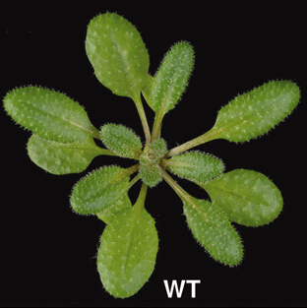
Loss of functional miR159 is deleterious to plant growth
miR159 family
miR159a
miR159b
miR159c
MYB33
MYB65
Validated targets
MYB101
miR159a: AUCUCGAGGGAAGUUAGGUUU-5’
miR159b: UUCUCGAGGGAAGUUAGGUUU-5’
miR159c: UCCUCGAGGGAAGUUAGGUUU-5’
MYB120
MYB 97
MYB104
GAMYB-like genes
mir159ab

Slide 6
Project Perspective
Scope of miR159-mediated gene regulation:
Besides GAMYB-like, are there any other genes regulated by miR159? Can miRNA regulate a wider range genes than what was thought previously?
Can miR159 mediate the silencing of transposable elements?
Mechanism of miR159-mediated regulation
Can miR159 regulate its targets by transcriptional silencing?
Is translation repression also involved in the regulation of miR159 targets?
Can the miRNA silencing signals be transported in vivo?

Slide 7
Genes other than GAMYB-like are highly complementary to miR159
No. of mismatches
miR159a: AUCUCGAGGGAAGUUAGGUUU-5’
miR159b: UUCUCGAGGGAAGUUAGGUUU-5’
miR159c: UCCUCGAGGGAAGUUAGGUUU-5’
OPT1 UAGAGCUUUCUUCAUUCCAAC-3’ 3-4
DUO1* UGGAGCUCCAUUCGAUCCAAA-3’ 2-3
SPL* AUGAGCUCUCUUCAAUCCAAA-3’ 1.5-2.5
U
PHD UAGAGCUCUCUUAAGUCUAAA-3’ 2.5-4.5
EP1 UAGGGUUAUCUUCAAUUCAAU-3’ 3.5-5.5
MRG1* UAGAGCCCCCUUCAAACCAAA-3’ 2-4
1g29010* UAGAGCCUCCUUCAAGCCAAA-3’ 2.5-4.5
F-BOX UAGGGUUUCUUUAAAUCCAAU-3’ 4-6
ACS8 UCGAGUUUCUUUCAAUCCAAA-3’ 2.5-3.5
4g15530 AAGAGUUUCCUUCAAUCCAAA-3’ 1-3
G
*: Conserved target ___: cleavage site
Red: perfect match
Green: G:U pair
Blue: Mismatch

Slide 8
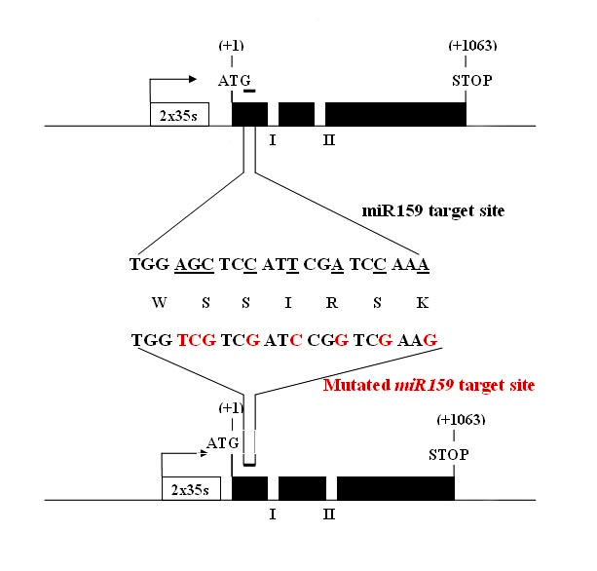
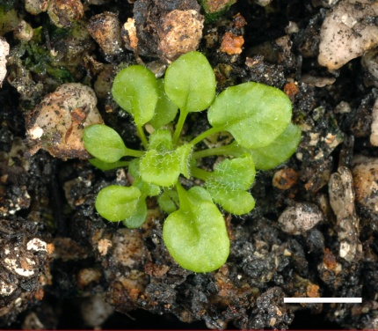
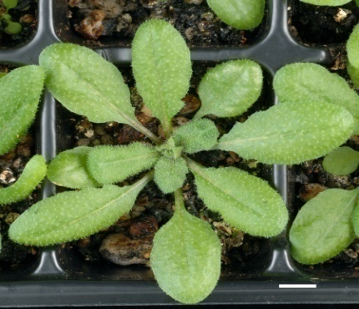
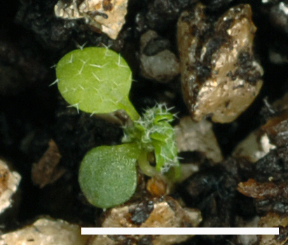
Overexpression of DUO1 lead to dramatic developmental defects
35s:DUO1
35s:DUO1
WT
35s:mDUO1
35s:mDUO1

Slide 9
The Ty3/Gypsy-like retrotransposons share a conserved miR159 target site
miR159a AUCUCGAGGGAAGUUAGGUUU
miR159b UUCUCGAGGGAAGUUAGGUUU
miR159c UCCUCGAGGGAAGUUAGGUUU No. of mismatches
AT4G22415 AGGAUCUCCCUUCAUUCCAAA 2-3.5
AT5G28335 AGGAUCUCCCUUCAUUCCAAA 2-3.5
AT1G35870 AGGAUCUCCUUUCAUUCCAAA 3-4.5
AT3G33076 AGGAUCUCCCUUCAUUCCAAA 2-3.5
AT3G33084 AGGAUCUCCCUUCAUUCCAAA 2-3.5
AT3G43675 AGUAUCUCCCUUCAUUCCAAA 3-4
Red: perfect match
Green: G:U pair
Blue: mismatch
____: cleavage site

Slide 10
Detection and mapping of miR159-mediated cleavage product in vivo
5’P
Cleaved mRNA
AAAAA
RNA adaptor Ligation
Adaptor
AAAAA
Retrotranscription
Position 10-11: True cleavage product
TTTTTT
cDNA
Nested PCR with Adaptor primer and gene-specific primer
Cloning and sequencing

Slide 11
Using Agrobacterium-mediated coinoculation system to test the potential regulation of miR159 on genes
Target
Transformed in tobacco
Expression level of the target gene
MIR159
Co-transformed in tobacco

Slide 12


Is miR159 involved in other gene silencing mechanisms?
In higher plants, endogenous short interfering RNAs (siRNAs) are believed to be involved in the methylation of chromatin, which is usually associated with transcriptional silencing of genes.
A single plant miRNA has been correlated with the methylation of its target genes ( miR165/166 vs Phabulosa).
Transcriptional gene silencing?
Target genes
miR159

Slide 13
Can miR159 mediate the methylation of its targets?
Chromatin-immunoprecipitation (ChIP)
Methylation-specific PCR
Bisulphite Sequencing
Methylation status of validated miR159 targets ,e.g. MYB33.
Detailed patterns of the methylation of miR159 targets.
Is the chromatin associated with targets also methylated?
mir159ab

Slide 14
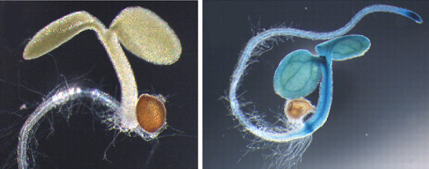
Transcript level and protein level of MYB33 do not correlate
MYB33 uncleaved transcripts is detected, while MYB33 protein is eliminated by miR159-mediated regulation.
The protein product of MYB33:GUS is accumulated to a high level in mir159ab, while only three-fold-elevation of MYB33 expression level was observed in mir159ab.
MYB33:GUS in Col-0
MYB33:GUS in mir159ab

Slide 15
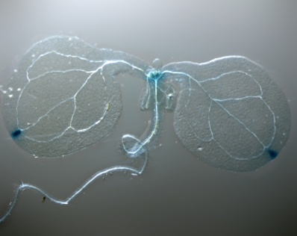
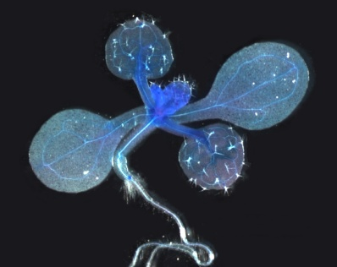
Can miR159 mediate the silencing of its target by translational repression?
Measure expression level of the transgenes separately
MYB33:GUS
Compare
Measure the GUS protein level using GUS antibody
mMYB33:GUS

Slide 16

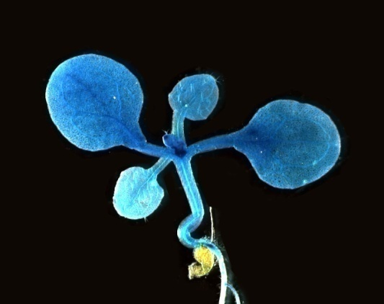

Transportation of miR159 in vivo
MIR159 is expressed where MYB33 is repressed
MIR159:GUS
mMYB33:GUS
However, miR159s are among the richest miRNAs found in phloem, which is the main transportation tissue in plants.

Slide 17
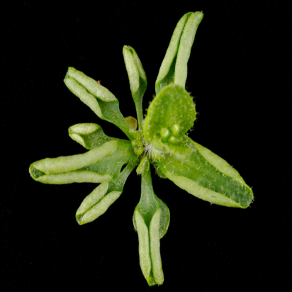
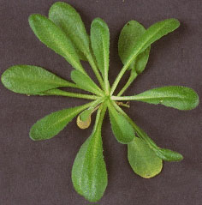
Can miR159 be transported in vivo to mediate gene repression?
Grafting experiments
mir159a/b : No functional miR159
?
miR159 transportation?
Col-0: Functional miR159
mir159ab
Col-0

Slide 18
Summary
How miRNAs work needs better understanding.
Insight into the scope of plant miRNA regulation and the underlying mechanisms will be gained.
Provide important information for the practical applications of miRNA-mediated gene regulation.

Slide 19
Thank you!

